Slide 1

Building & Mining Knowledge Graphs
(KEN4256)
Lab 1: Resource Description Framework (RDF) basics

Slide 2
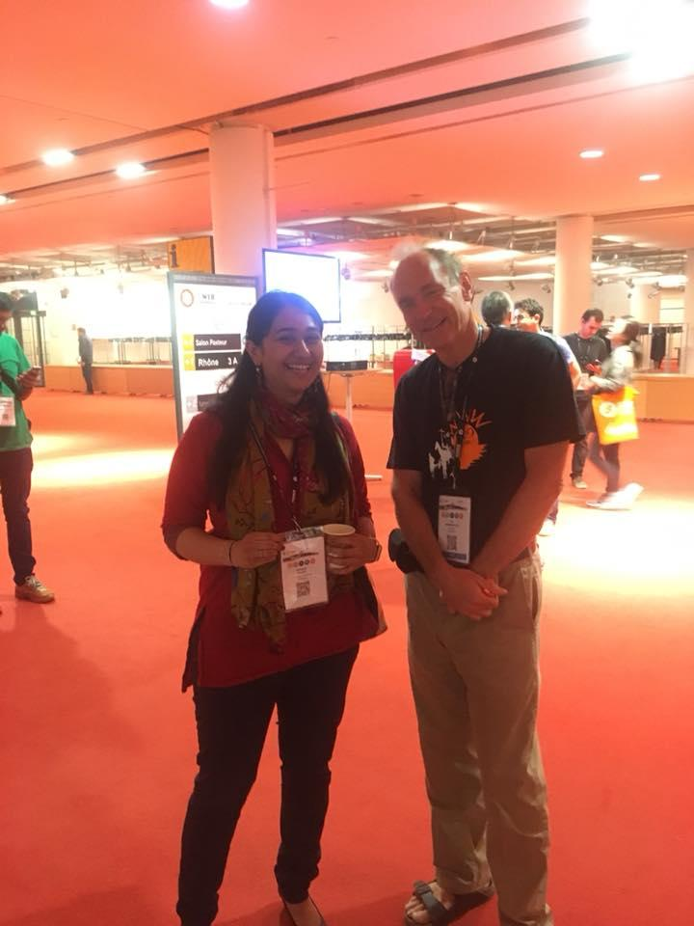
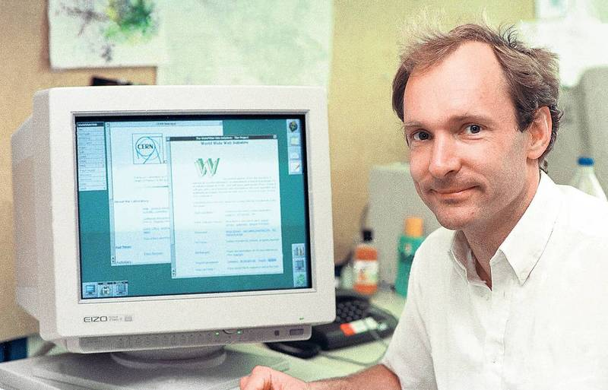
Tim Berners-Lee
Inventor of the World Wide Web

Slide 3
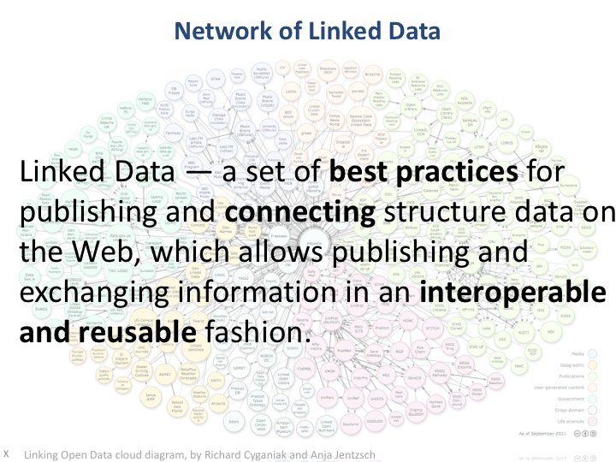

Slide 4
Linked Data Principles
Use Uniform Resource Identifiers (URIs) as names for things.
Use HTTP URIs, so that people can look up those names.
When someone looks up a URI, provide useful information, using the standards (RDF, RDFS, OWL, SPARQL).
Include links to other URIs, so that they can discover more things.

Slide 5
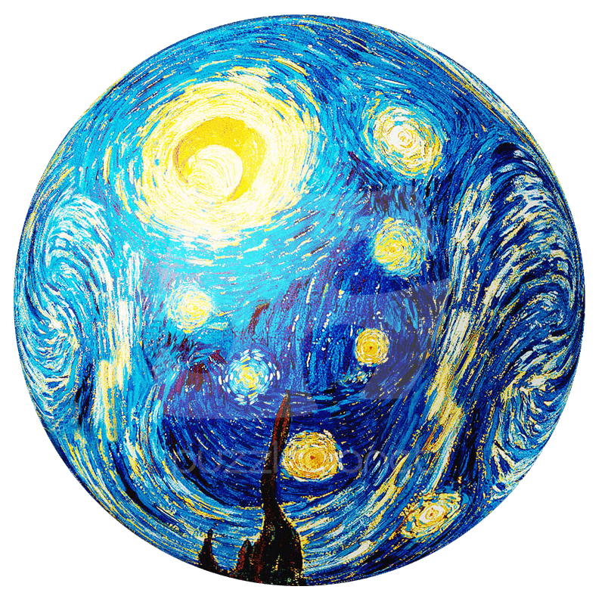
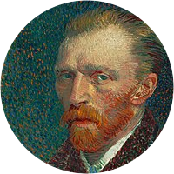
Resource Description Framework (RDF)
Knowledge is represented in RDF in the form of “Triples”
Subject: URI
Predicate: URI (a.k.a. Property or relation)
Object: URI or literal
Artwork:
Artist:
createdBy
Vincent van Gogh
Starry Night
Netherlands
<http://example.com/starrynight> <http://example.com/createdBy> <http://example.com/Vincent_van_Gogh>
Subject
Predicate
Object

Slide 6
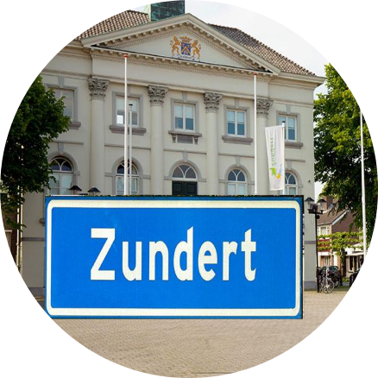
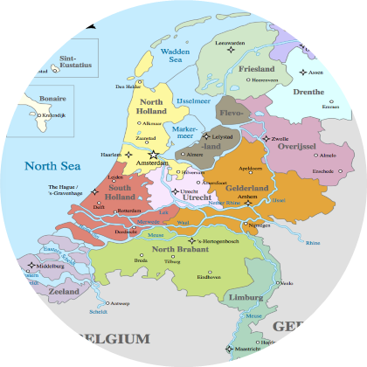
Let’s write these triples together
Encoding knowledge in RDF
Artwork:
Artist:
createdBy
Vincent van Gogh
Starry Night
bornIn
City:
Zundert
Country:
Validate your RDF:
https://www.w3.org/2015/03/ShExValidata
partOf
Netherlands

Slide 7
Adding meaning to the information
<http://example.com/starrynight> <http://example.com/createdBy> <http://example.com/Vincent_van_Gogh> .
<http://example.com/starrynight> <http://www.w3.org/1999/02/22-rdf-syntax-ns#type> <http://example.com/Artwork> .
<http://example.com/Vincent_van_Gogh> <http://www.w3.org/1999/02/22-rdf-syntax-ns#type> <http://example.com/Artist> .
<http://example.com/Vincent_van_Gogh> <http://example.com/bornIn> <http://example.com/Zundert> .
<http://example.com/Zundert> <http://example.com/partOf> <http://example.com/Netherlands> .
?
Add triples to give types for Zundert and Netherlands

Slide 8
Prefixes
PREFIX rdf: <http://www.w3.org/1999/02/22-rdf-syntax-ns#>
PREFIX ex: <http://example.com/>
ex:starrynight ex:createdBy ex:Vincent_van_Gogh .
ex:starrynight rdf:type ex:Artwork .
ex:Vincent_van_Gogh rdf:type ex:Artist .
ex:Vincent_van_Gogh ex:bornIn ex:Zundert .
ex:Zundert ex:partOf ex:Netherlands .
ex:Zundert rdf:type ex:City .
ex:Netherlands rdf:type ex:Country .
Shorthand!
Keeps information concise and readable

Slide 9
Identifiers, Literals & Datatypes
<http://example.com/starrynight>
Unique alphanumeric codes (identifiers) sometimes used for resource names in KGs found on the Web (e.g. Wikidata)
Literals can be specified as objects in triples e.g. strings, integers.
If data types are not specified for literals, they are treated as strings
Literals may never be used for subjects or predicates of triples!
Namespace
Resource name
https://www.wikidata.org/wiki/Q45585
<../DKE> <../hasAge> “25”^^<http://www.w3.org/2001/XMLSchema#nonNegativeInteger>
<../Maastricht> <../hasDescription> “Maastricht is a city on the southern tip of the Netherlands”@en

Slide 10
Identifiers, Literals & Datatypes
PREFIX rdf: <http://www.w3.org/1999/02/22-rdf-syntax-ns#>
PREFIX ex: <http://example.com/>
PREFIX rdfs: <http://www.w3.org/2000/01/rdf-schema#>
PREFIX wd: <https://www.wikidata.org/wiki/>
wd:Q45585 ex:createdBy ex:Vincent_van_Gogh .
wd:Q45585 rdf:type ex:Artwork .
ex:Vincent_van_Gogh rdf:type ex:Artist .
ex:Vincent_van_Gogh ex:bornIn ex:Zundert .
ex:Zundert ex:partOf ex:Netherlands .
ex:Zundert rdf:type ex:City .
ex:Netherlands rdf:type ex:Country .
wd:Q45585 rdfs:label “The Starry Night”@en .
ex:Vincent_van_Gogh ex:hasAge “37”^^<http://www.w3.org/2001/XMLSchema#nonNegativeInteger>

Slide 11
Identifiers, Literals & Datatypes
PREFIX rdf: <http://www.w3.org/1999/02/22-rdf-syntax-ns#>
PREFIX ex: <http://example.com/>
PREFIX rdfs: <http://www.w3.org/2000/01/rdf-schema#>
PREFIX wd: <https://www.wikidata.org/wiki/>
PREFIX xsd: <http://www.w3.org/2001/XMLSchema#>
wd:Q45585 ex:createdBy ex:Vincent_van_Gogh .
wd:Q45585 rdf:type ex:Artwork .
ex:Vincent_van_Gogh rdf:type ex:Artist .
ex:Vincent_van_Gogh ex:bornIn ex:Zundert .
ex:Zundert ex:partOf ex:Netherlands .
ex:Zundert rdf:type ex:City .
ex:Netherlands rdf:type ex:Country .
wd:Q45585 rdfs:label “The Starry Night”@en .
ex:Vincent_van_Gogh ex:hasAge “37”^^xsd:nonNegativeInteger .

Slide 12
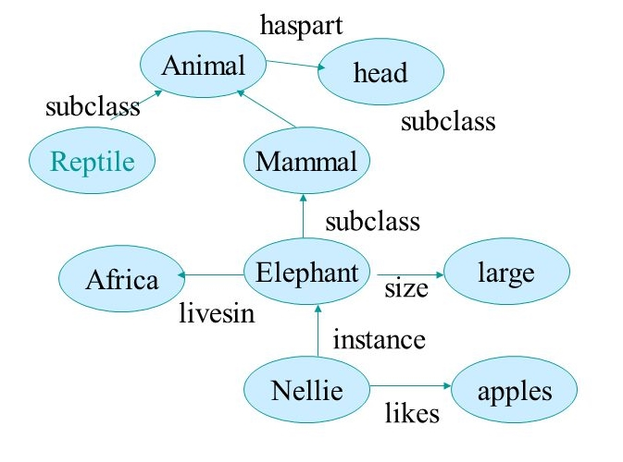
Ontologies
“A formal specification of knowledge in a domain in a way that enables machines to derive implicit information from it”

Slide 13
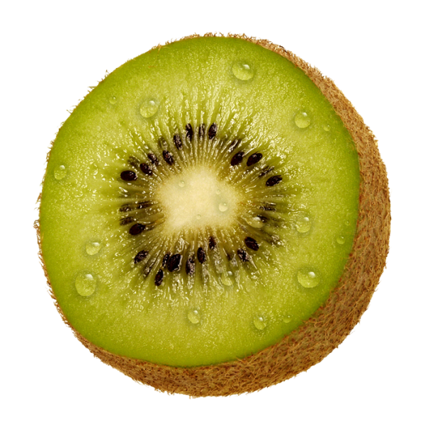
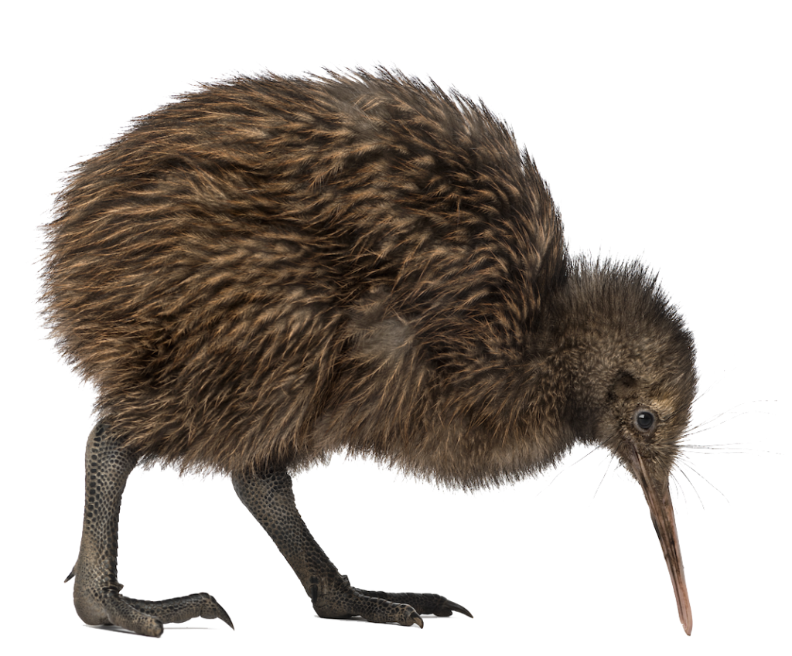
Shared vocabularies
Defines the “meaning” of predicates and types used in Knowledge Graphs
What do you mean by “Kiwi”?
or
http://www.fruitontology.org/kiwi
http://www.rarebirds.org/kiwi

Slide 14
Identifiers, Literals & Datatypes
wd:Q45585 ex:createdBy ex:Vincent_van_Gogh .
wd:Q45585 rdf:type ex:Artwork .
ex:Vincent_van_Gogh rdf:type ex:Artist .
ex:Vincent_van_Gogh ex:bornIn ex:Zundert .
ex:Zundert ex:partOf ex:Netherlands .
ex:Zundert rdf:type ex:City .
ex:Netherlands rdf:type ex:Country .
wd:Q45585 rdfs:label “The Starry Night”@en .
ex:Vincent_van_Gogh ex:hasAge “37”^^xsd:nonNegativeInteger .
Can you find shared vocabulary terms to define our types and predicates?
http://dublincore.org/documents/dcmi-terms/
https://lov.linkeddata.es/dataset/lov/
Notes:
Add final set of triples (model answer)

Slide 15
http://mappings.dbpedia.org/server/ontology/classes/

Slide 16

You have created your first RDF knowledge graph!

